Slide 1
New Program Proposal Process
Presented by the Georgia Tech Office of Academic Effectiveness (OAE)
Content based on Georgia Tech, University System of Georgia (USG), and Southern Association of Colleges and Schools Commission on Colleges (SACSCOC) policies in effect on April 14, 2026

Slide 2
Process Overview
Informal presentation
Present the highlights of the proposal to the appropriate curriculum committee for comment. Make corrections or add information as recommended before completing step number 2.
Complete New Program Proposal Documentation (for USG) and Prospectus (if required for SACSCOC).
Complete internal processes:
Approval by School/College curriculum committee
Approval by the Institute Undergraduate or Graduate Curriculum Committee
Approval by the Academic Faculty Senate
Complete external processes (these steps are taken by OAE after approval by the Academic Faculty Senate):
Communication with the USG/BOR
Communication with SACSCOC
Notifications to campus stakeholders when a decision is reached
Implement your new program!

Slide 3
1. Informal Presentation
When faculty consider proposing a new program, we suggest that they attend an ICC meeting to talk about it.
There is no formal document. Faculty prepare a few slides with talking points.
The presentation is informal and intended to solicit feedback before faculty put significant work into a formal proposal.
Faculty have found this informal chat with the ICC’s to be very useful. It lets the proposers know in advance where the Committee might have concerns or be confused.
Contact:
Amy Hodges
Assistant Registrar-Curriculum
amy.hodges@registrar.gatech.edu

Slide 4

2. Complete New Program Proposal Documentation
USG New Program Proposal Application
USG Budget Form
SACSCOC Significant Departure worksheet
Work with OAE to determine next steps for SACSCOC
0%-49% new content = no action (NEW)
50%-100% new content = submit prospectus to SACSCOC for approval
SACSCOC Prospectus (if required)
Faculty Roster Note:
Include one qualified faculty member per course in the new program
Institutional Research & Planning (IRP) Office supports institutional data needs. IRP identifies aspects of a well thought out data request on their website.
Georgia Tech publishes public and FERPA-protected dashboards at https://lite.gatech.edu/.
See the Institute Finance Support website for budget related support.

Slide 5
3. Complete Internal Processes
New Program-proposing faculty work with the Registrar’s Office to submit documents and be added to the appropriate meeting agendas:
Not necessary, but suggested – prepare an informational presentation for the curriculum committee to explain the rationale for the new program and the basic requirements (Registrar's Office will coordinate getting it on the agenda and assisting with content questions, typically a brief set of PP slides).
Complete New Degree Program Signature Page
Submit new program proposal documentation to the Registrar's Office so that it can be reviewed by the appropriate Vice Provost (undergraduate or graduate education) and respond to any questions that the Vice Provost raises. The Registrar's Office will inform the proposer of the ICC meeting date and send a calendar invite.
If approved at the ICC level, the Registrar's Office includes the new program as an action item for the Academic Faculty Senate at its next meeting. If approved, OAE takes over.
Amy Hodges
Assistant Registrar-Curriculum
amy.hodges@registrar.gatech.edu
Natalie Brown
Business Analyst
natalie.brown@registrar.gatech.edu

Slide 6
4. Complete External Processes
OAE partners with the new program-proposing faculty members to submit external documentation following approval by the Academic Faculty Senate. The proposal is not officially approved at the Institute level until the Academic Faculty Senate acts on it. There are 4 Senate meetings per year, October and November in the Fall and February and April in the Spring. It can take some time for the Senate approved program to appear on the BOR agenda. This can be a lengthy process.
Submit new program proposal documentation to the USG for approval.
Final Signature Attachment for USG Submission (PDF | Word)
Submit notification or prospectus to SACSCOC, if required.
Franz Reneau
Interim Associate Provost for Academic Effectiveness
franz.reneau@gatech.edu
Lauren Farmer
Accreditation Manager and Interim SACSCOC Liaison
lauren.farmer@gatech.edu

Slide 7
Suggested Timeline
Complete internal processes in Spring and early Fall semester
Complete external processes before Winter Recess
Implement in the following Fall semester, if possible
All of this is a time-sensitive continuum of activities
New GT Catalog published each year in May
New program must have BOR approval prior to May of each year to appear in the new Catalog and be active
Once the new program is on the ICC agenda for approval, the Registrar's Office works with the admission offices so that they are aware of a possible new degree program
Important to ensure that the application for admission is updated with the new degree option when it is approved
Registrar's Office must also complete all of the coding for the approved new degree in the SIS (Banner) so that students can be admitted to and enrolled in the new program
Note: Advertising or marketing for a new program cannot occur until the new program is fully approved by the Board of Regents

Slide 8
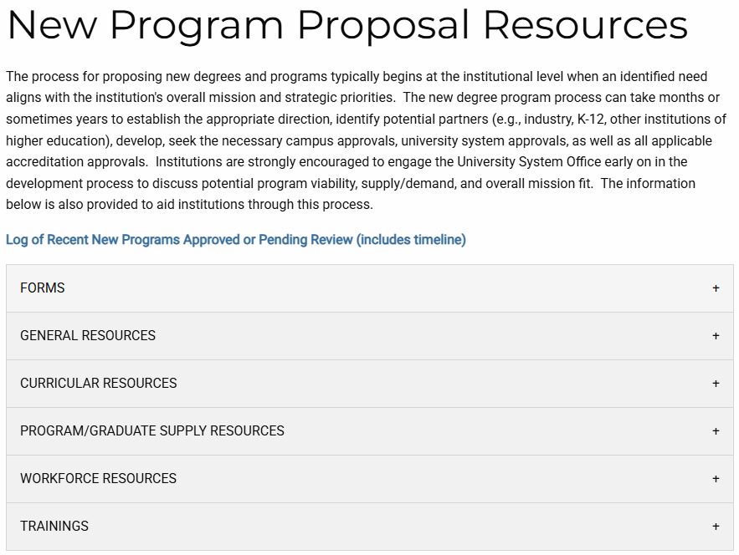
Review Resources
https://www.usg.edu/academic_programs/new_program_review
Forms and templates
Meeting dates
Curricular resources
Dashboard links
Workforce-related resources
Recorded webinar trainings

Slide 9
Questions?

